Slide 1
FDP-50-A-1 Amendment of Village of Oakland Mills Sections 2- Area 2 Village Center
Planning Board Meeting
July 21, 2022

Slide 2
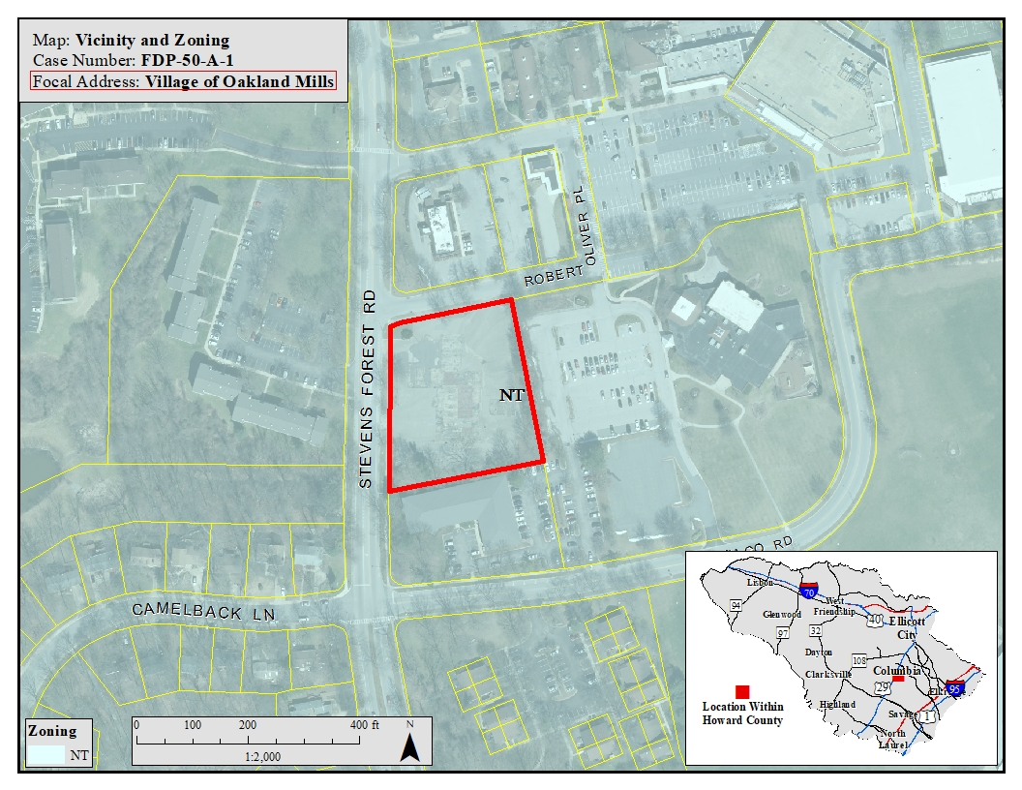
Subject Property Vicinity

Slide 3
Purpose of the FDP Amendment
Add a motor vehicle fueling facility as a permitted use for Lot 8
Provide criteria for Motor Vehicle Fuel Facilities to the FDP

Slide 4
Existing Site Conditions

Slide 5
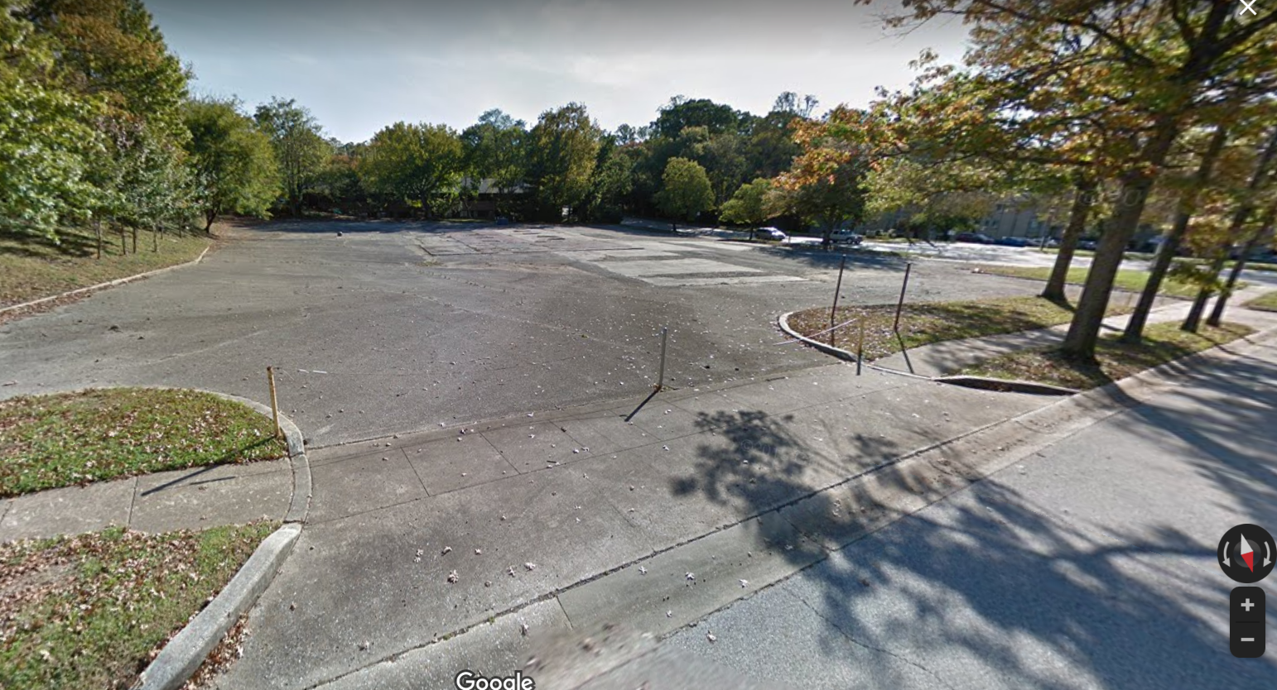
Existing Site Conditions

Slide 6
Location on FDP

Slide 7
Site History
FDP Phase 50 – Lot 8 Employment Center Commercial
SDP-70-011 - Developed in 1970s as a gas station
Gas station was a use permitted by right in B-2 and SC zoning
Gas station and tanks removed 20+ years ago
No subsequent development
PDP amendment
SDP-07-087 approved but not developed (office/retail)

Slide 8
CB46-2016
Revised Zoning Regulations
Add standards and criteria for Motor Vehicle Fueling Facilities (MVFF)
ZRA-159 established Section 125.0.A.11 to ensure SDPs for MVFF in NewTown meet conditional use criteria
Petitioner proposes use and criteria on FDP
Adding the new criteria to FDP is not required
Future SDP for MVFF will need to comply with the criteria
Planning Board will review future SDP for compliance with Section 131.0.O.2 (MVFF) and apply criteria

Slide 9
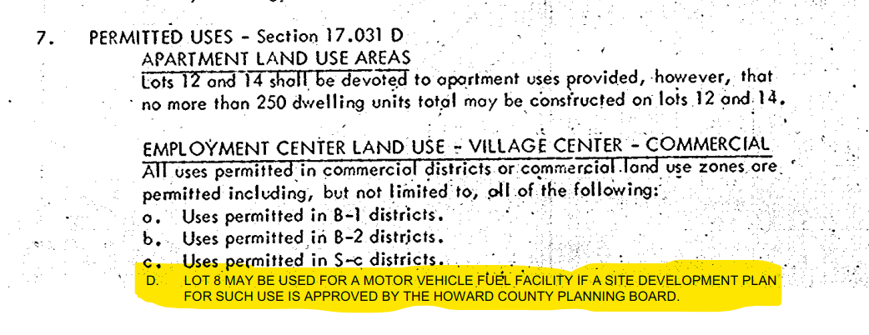
FDP-50-A-1 Criteria Changes Sheet 2

Slide 10
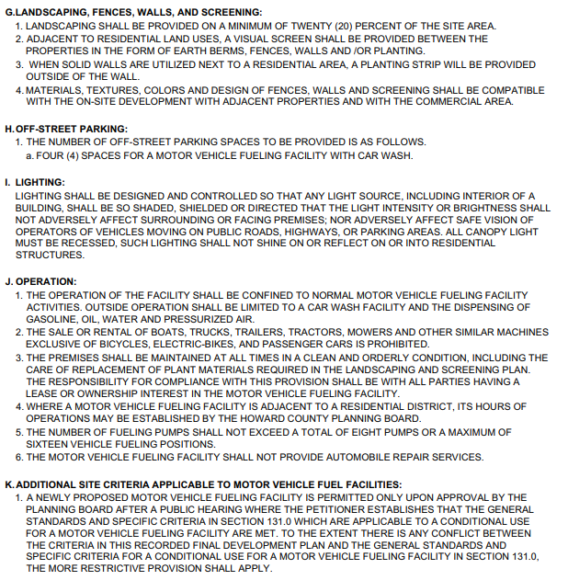
FDP-50-A-1 Criteria Changes Sheet 4

