Slide 1
5005 Straight Star Place Village of Harpers Choice, Section 7, Area 4, Lot 2 PB-454 & FDP-204-A-1 Planning Board Hearing July 21, 2022
Request to amend the Final Development Plan to permit an accessory apartment use on the subject property.

Slide 2
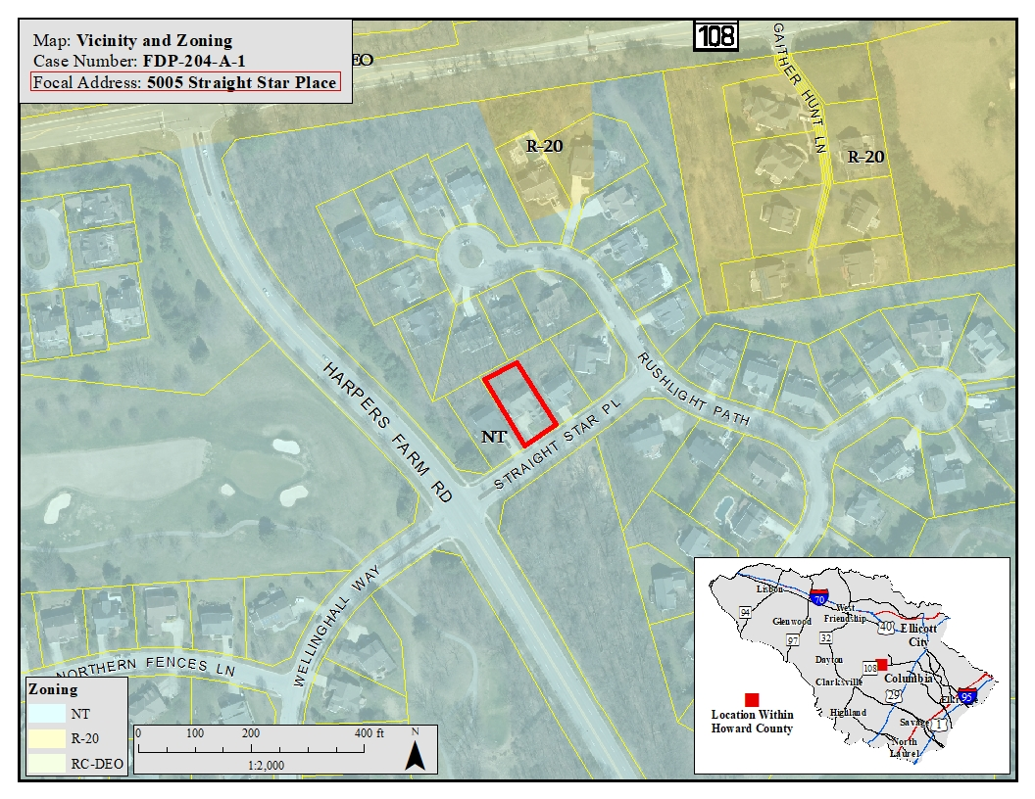
Location

Slide 3
Process to Permit an Accessory Apartment Use
Section 125.0.A.7.c – The accessory use provisions of Section 110.0 shall be applicable to all residential uses in the NT district.
Section 110.C.2 (Residential – Single Cluster):
Accessory apartments, subject to the requirements of Section 128.0.A, provided that:
The area of the lot is at least 12,000 square feet;
Except for an exterior entrance and necessary parking area there shall be no external evidence of the accessory apartment; and,
The accessory apartment shall have no more than two bedrooms.

Slide 4
Process to Permit an Accessory Apartment Use
Section 125.0.F.2 allows a property owner to request an additional use on individual lots in residential land use areas, which is not allowed by the Final Development Plan.
No FDP amendment shall be proposed which would either alter the land use designation established by the Comprehensive Sketch Plan or allow an increase in residential density.
The Zoning Regulations define “Density” as the number of principal dwelling units per unit of land area. Accessory dwelling units such as accessory apartments are not included when calculating density.

Slide 5
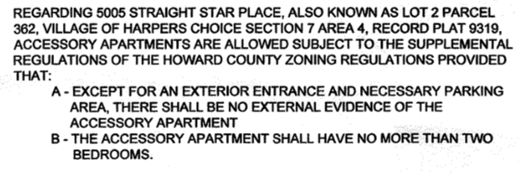
Proposed FDP Amendment
Revise criterion 7A-1 on FDP sheet #2 to add:

Slide 6
Supplemental Zoning Regulations for Accessory Apartments
The accessory apartment must be located within an owner occupied dwelling. The owner may occupy either the principal dwelling or the accessory apartment.
If the accessory apartment is within an addition to the existing dwelling it must share a common wall overlap of at least 50% of the length of the shared wall. The apartment cannot be separated from the principal dwelling by an attached garage or a breezeway.
In all dwellings, an accessory apartment shall occupy no more than one-third of the net floor area of the building, up to a maximum of 1,500 square feet.
An accessory apartment shall operate only upon approval of a permit issued by the Department of Planning and Zoning.

Slide 8
Planning Board Evaluation
Pursuant to Section 125.0.F.2.c, the Planning Board shall approve, approve with modifications or deny the proposed amendment to the Final Development Plan, stating the reasons for its action. The Planning Board shall approve the request only if it finds:
The use is consistent with the land use designation of the property as established on the recorded final development plan and compatible with existing or proposed development in the vicinity.
The use will not adversely affect vicinal properties.

