Slide 1
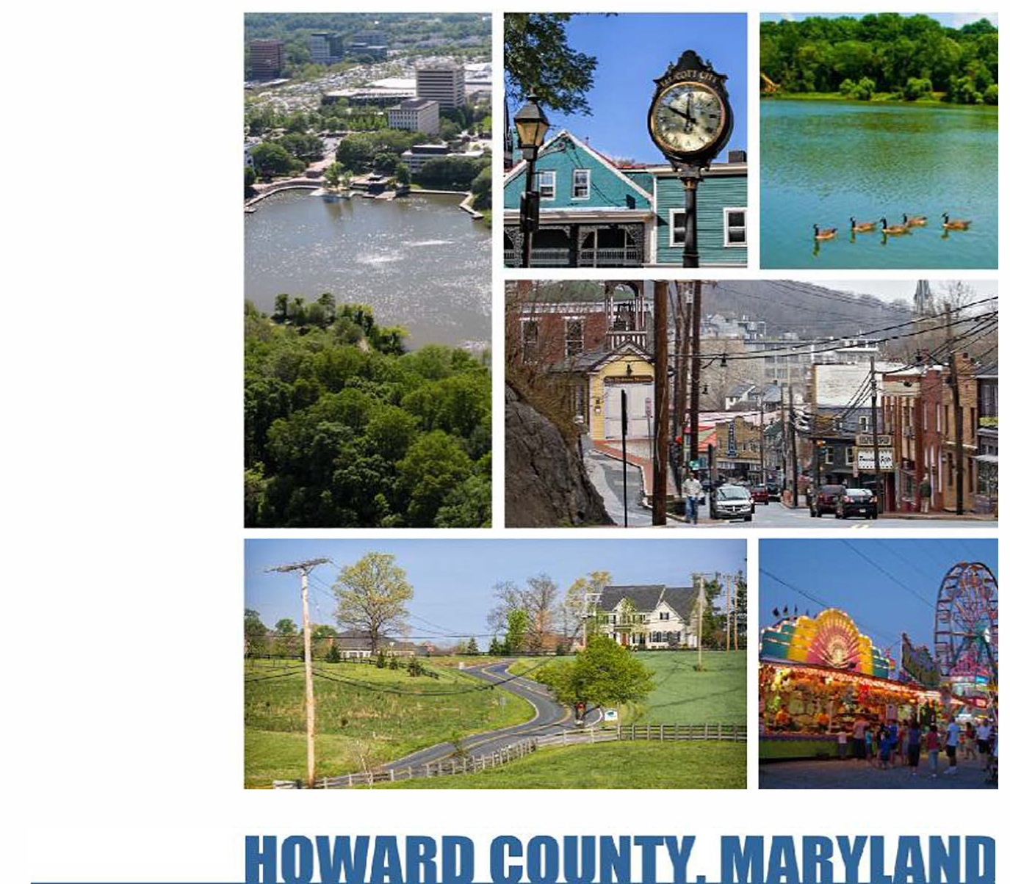
Land Development Code Update
Phase 1: Development Regulations Assessment
JULY 2017

Slide 2
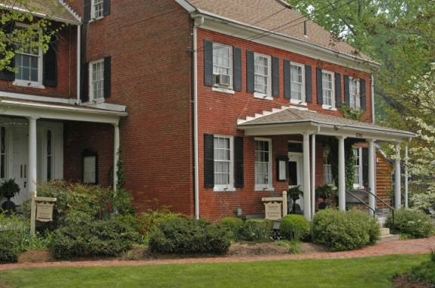
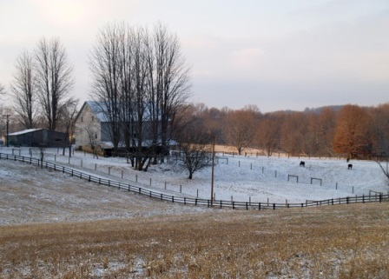
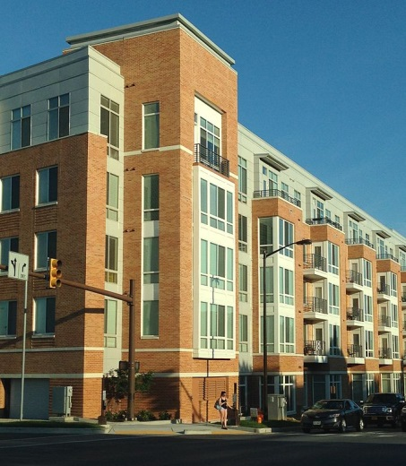
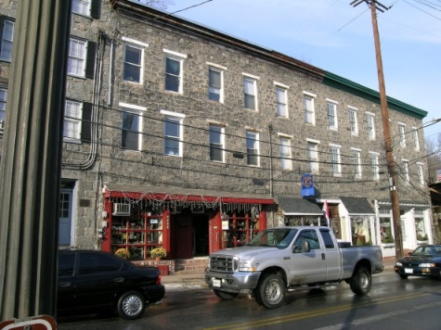
SUMMARY
Project Background
General Update
Discussion Topics

Slide 3
PROJECT BACKGROUND

Slide 4
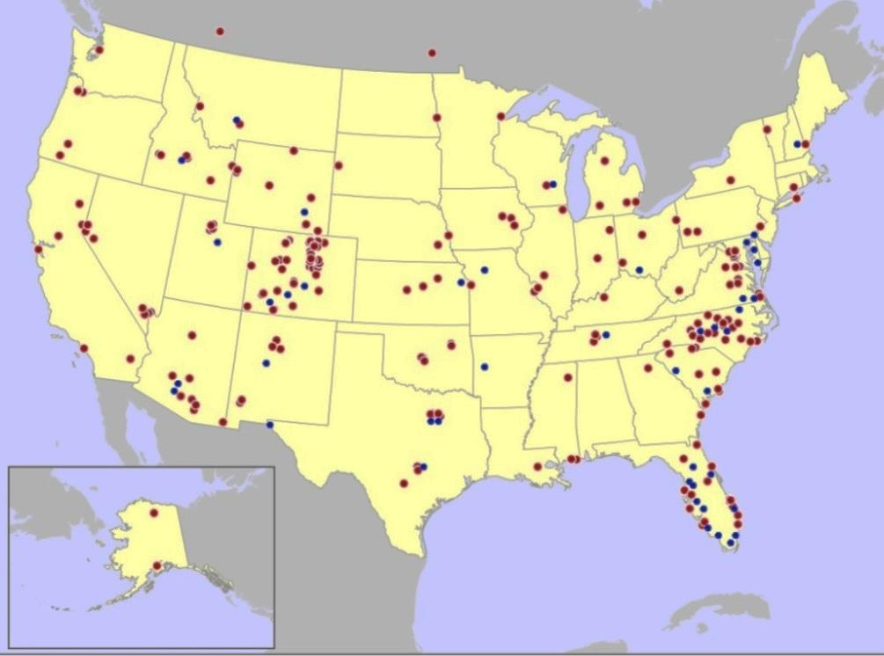
THE CLARION TEAM
Significant Mid-Atlantic and national experience updating development codes
Significant experience updating codes in communities with varied urban, suburban, and rural context areas
National leaders in zoning best practices and sustainable development regulations

Slide 5
PROJECT TEAM
Don Elliott, FAICP, Esq., Director
Lisa Steiner, AICP Associate
Eric Wencel
Associate

Slide 6
PHASE 1 PROJECT APPROACH
COMMON GOALS FOR CODE UPDATES
Modern code format and structure
Context-sensitive regulations
Flexible provisions
Efficient approval processes
High-quality design
Sustainable development patterns

Slide 7
TIMELINE
Stakeholder Interviews and Public Meetings
March 2017
Online Survey and Comments
June 2017
Emerging Issues and Trade-Offs Public Meetings
July 2017
Diagnosis and Annotated Outline Draft
Fall 2017
Presentation of Draft Public Meetings
Winter 2018

Slide 8
GENERAL UPDATE

Slide 9
CURRENTLY UNDERWAY
Review Current Regulations
Review Four Manuals
Review Columbia/New Town FDPs
Collect and Analyze Public Comments
Collect and Analyze On-line Survey Results

Slide 10
NEXT STEPS
Continue:
Collecting online comments
Collecting letter comments
Updates on website/social media
Review feedback from this round of meetings
Begin drafting the Diagnosis and Annotated Outline

Slide 11
EMERGING ISSUES
General impressions based on reviews & responses to date:
Need to consolidate/eliminate seldom used and poorly functioning districts
Need to consolidate numerous and overly detailed uses and conditions
Need to simplify some complex procedures while retaining public engagement in those decisions
Need to evaluate New Town zoning to preserve key characteristics for long-term effectiveness
Need to be consistent with Maryland law and adopted plans – this is not a re-planning project

Slide 12
DISCUSSION TOPICS

Slide 13
CONDITIONAL USES
Many comments address Conditional Uses
Many appear motivated by concern over density, size, or potential traffic impacts of age-restricted communities
Some related to rural land uses
Almost all zoning ordinances have Conditional Uses
It’s very difficult to govern a large community without them
It’s very common that the right answer to “does it belong here” is “well, that depends on what’s around it and whether the applicant can mitigate any impacts on what’s around it.”

Slide 14
CONDITIONAL USES
Given that Conditional Uses are a very useful land use tool:
What – specifically – is wrong with the current system?
What uses should not be Conditional in what areas?
What uses that are now Permitted uses (if any) should become Conditional uses?
What conditions should be added to specific uses – (or, if they already exist, should be enforced better)?
How should the review process for Conditional Use applications be changed?

Slide 15
INFILL AND REDEVELOPMENT
Many comments address Infill and Redevelopment
Some appear to be general opinions that it would be nice if growth were not coming to Howard County
Others appear to object to how specific projects “don’t fit” with the character of the areas where they were approved
Remember:
Maryland law generally requires the counties plan for anticipated growth (they don’t have to encourage it, but they can’t ignore it)
Maryland law generally requires that it be accommodated on less agriculturally productive/less environmentally sensitive lands
Howard County has a plan that complies with those laws

Slide 16
INFILL AND REDEVELOPMENT
Given that growth must go somewhere, preferably on less productive/less sensitive lands:
What types of infill development – if any – do you think have been done badly – and why don’t they “fit”:
Too much density or height?
Too much development in one place?
Use is too different from what is around it?
Not enough buffering/setback from surrounding uses?
Architecture or design seems out of place?
Design is too monotonous?

Slide 17
QUALITY OF DEVELOPMENT
Many comments address Quality of Development
“Quality” is a matter of perception (and often subjective)
Perceived “quality” often has many components, but the two most common that can be addressed by zoning and subdivision regulations are site design and building design
All zoning and subdivision regulations address site design
Most try to avoid all but basic controls over building design because “taste is subjective,” staff time to review building designs is limited, and (in most cases), political will to enforce detailed building design regulations is weak.

Slide 18
QUALITY OF DEVELOPMENT
What aspects of site design do you think need to be improved?
Access points and auto/bicycle/pedestrian circulation and connectivity?
Landscaping, trees, open space, stormwater, drainage?
Parking location or amount?
Lighting?
What aspects of (multi-family or non-residential) building design do you think need to be improved?
Location and orientation of buildings?
Location and orientation of doors and windows?
Articulation or design of facades facing streets or open spaces?
Monotony / variety?

Slide 19
AGRICULTURAL / RESIDENTIAL EDGES
Recently, there has been some controversy over compatibility and/or buffering of agricultural land uses from adjacent residential homes.
Most growing counties with viable agricultural uses struggle with this issue because:
The nature of rural land use changes as intact agricultural areas get smaller, the economics of traditional “growing/grazing” uses don’t work for smaller parcels, and owners need to find new uses that will allow them to say on the land longer
The “impositions” on the agricultural/residential edges go both ways

Slide 20
AGRICULTURAL / RESIDENTIAL EDGES
In light of this background, what do you think can or should be done to reduce future controversies over agricultural/residential edge conditions?
Require bigger setbacks and/or more landscaped buffering from residential uses that locate adjacent to agricultural land?
Require size and operational limits on new (non-traditional) agricultural land uses?
Require disclosure and “nuisance waivers” to be signed when a purchaser buys a home within X distance of an agricultural use?
Make more new and non-traditional agricultural uses Conditional Uses?
Better enforcement of existing controls and conditions?

Slide 21
KEY CORRIDORS
Some comments address the functioning of the Route 1 and Route 40 corridors and the quality of development along them:
Corridors are never “one place” – they are a sequence of places that almost always require several different zoning tools.
There is fairly broad consensus that the CE, CAC, TOD, and CLI districts adopted in 2004 have not produced the desired result along Route 1 (so a new study of that route will begin soon).
There is some feeling that the TNC overlay district used along Route 40 has also not produced desired results.

Slide 22
KEY CORRIDORS
What do you think Howard County can or should do to better guide development and redevelopment along the Route 1 and Route 40 corridors?
More/less concentration of density at key intersections?
Requiring “stepdowns” in height or density at the edges of low-density development?
Widening or narrowing the range of permitted land uses (e.g. the commercial and light industrial uses currently in place)
Requiring more / less parking?
Requiring more / less setbacks and open space?
Something else?

Slide 23
QUESTIONS & DISCUSSION

