Slide 1
Committed to [Life] Safety
Brad Tanner
Director of Community Outreach and Media Affairs
Howard County Department of Fire & Rescue Services

Slide 2
Department Overview
Structure
Combination system of nearly 900 career and volunteer providers operating from 13 fire stations across the County.
The department is responsible for the administration of the affairs for the County in:
fire suppression and prevention
fire training
arson investigation
rescue services, emergency medical services, and hazardous material

Slide 3
Location of Stations/Facilities

Slide 4
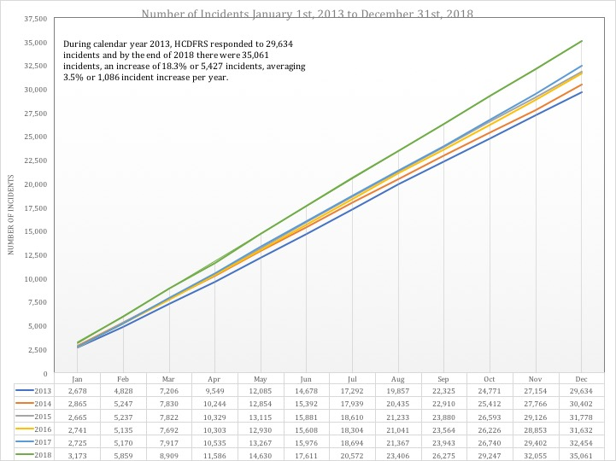
Statistics to Know

Slide 5
Statistics to Know
Average number of incidents per square mile: 135
Average incidents responded to daily: 93 to 94
Busiest day of the week: Friday
Peak timeframe: 10:00AM to 6:59PM (52% of all incidents occurred during these 8 hours)

Slide 6
Risk Reduction Programs
Community CPR
Stop the Bleed
Narcan / Naloxone Use
Fire and Fall Safety for Aging Adults
Fire Prevention Safety House
Home Safety Visits
Smoke Alarm Canvassing
Safe Kids

Slide 7
Good Samaritan Law
Maryland Courts and Judicial Proceedings Code
§ 5-603
“An individual who is not [licensed in this state to provide medical care] is not civilly liable for any act or omission in providing assistance or medical aid to a victim at the scene of an emergency, if:
(1) The assistance or aid is provided in a reasonably prudent manner;
(2) The assistance or aid is provided without fee or other compensation; and
(3) The individual relinquishes care of the victim when someone who is licensed or certified by this State to provide medical care or services becomes available to take responsibility.”

Slide 8
Stop the Bleed
Notes:
Many injury mechanisms can result in serious bleeding.
While mass shootings currently get a lot of attention, serious bleeding is more likely to result from everyday injuries such as those that may occur at home, at work or while on the road.

Slide 9
Stop the Bleed
B Bleeding
Arms and legs
Neck, armpits, and groin
Body
Notes:
Let’s talk more about wounds that can cause death due to bleeding:
Bleeding from wounds located on the arms or the legs can usually be controlled by applying direct pressure on the wound itself or by placing a tourniquet on the arm or leg above the wound and tightening it until the bleeding stops.
Injuries to the groin, shoulder/armpit, and neck are often referred to as junctional wounds.
This is where the arms, legs, and head join with the torso, hence the name junctional.
A tourniquet cannot be applied in these locations and a different management approach to active bleeding is required.
In order to control bleeding from these anatomic locations, you need to pack or fill the wound and then apply direct pressure.
Wounds located on the chest or abdomen (front, side, or back) can be associated with internal bleeding.
You cannot control internal bleeding outside the hospital setting.
The most important action you can take in these cases is to quickly recognize the potential for internal bleeding and to call 9-1-1. Make sure to alert the first responders about any wounds you may have identified.

Slide 10
Howard County Department of Fire and Rescue Services
Adult, child & infant CPR, AED and Choking relief
Notes:
Hello Welcome. Introduce yourself, state your background and if anyone has any questions please ask. A popular video is Vinnie Jones Hands-Only CPR. https://youtu.be/NubYJoP7Nf4.

Slide 11
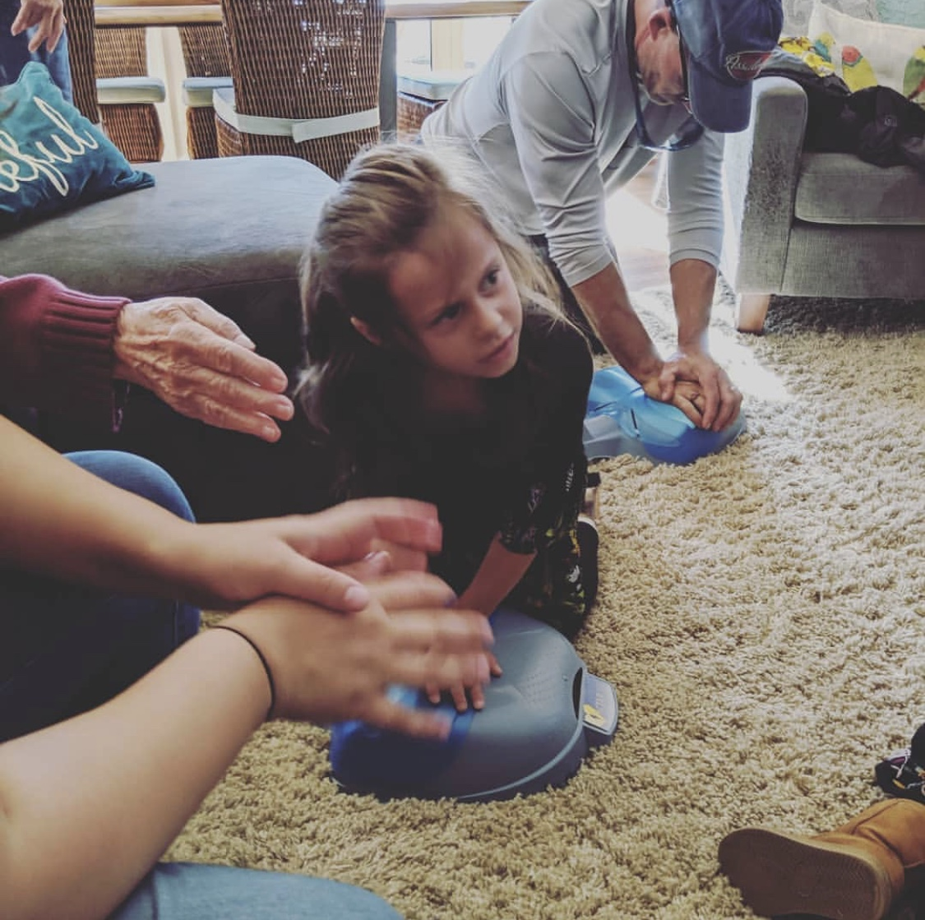
Who is this program for...

Slide 12
We provide optional Narcan trainings at the end of our programs.
Narcan is the drug we administer to reverse opioid overdoses.
Training takes 10 minutes.

Slide 13
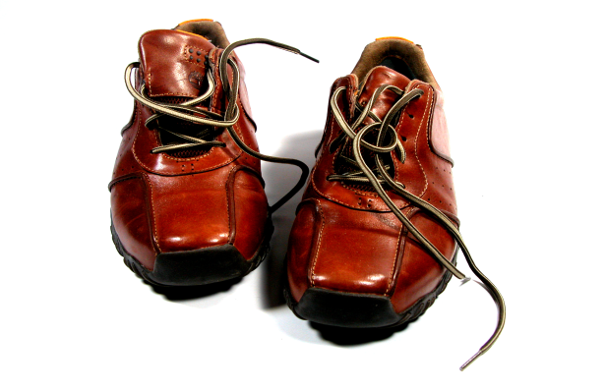
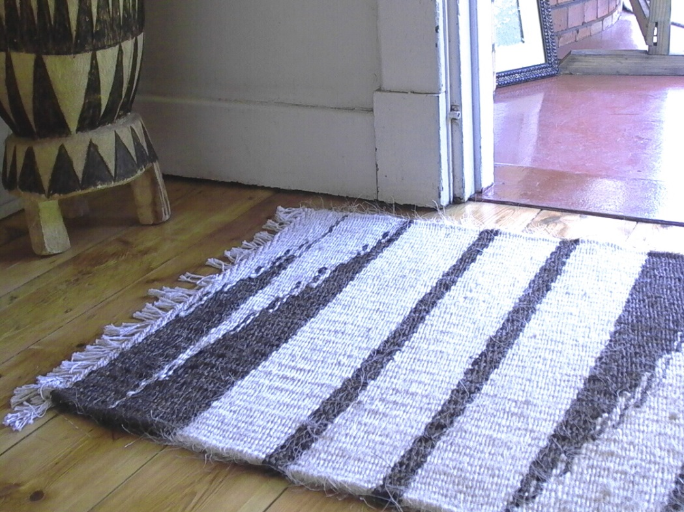
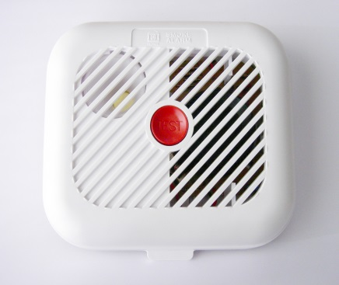
Howard County Fire and Rescue presents:
FIRE AND FALL PREVENTION FOR AGING ADULTS
Notes:
Hello all, welcome and thank you for joining us for our presentation of a fire and fall prevention program for older adults. This is a nationally accredited program created by the NFPA, or the National Fire Protection Association. It is a new program for Howard County, and because of this, I am going to ask you to fill out a survey at the end of the presentation: In the survey you can tell us what you don’t like, make suggestions, or tell us what you enjoyed so we can keep doing it!
Howard County adopted the Remembering When program for a couple of different reasons. First and foremost, we were faced with some grave statistics, that: “At age 65, older adults are twice as likely to be killed or injured by fires compared to the population at large. By age 75, that risk increases to three times that of the general population – and to four times by age 85. We also found that fires and burns are not the only hazards that threaten our older citizens.” (National Fire Protection Association, 2016) Falls are the leading cause of injury and death to this demographic.
We also found that there is a rise and expected increase to the demographic in Howard County. “In 2010, 10 percent of residents were 65 or older. By 2025, this will increase to 18 percent and by 2035, to nearly 22 percent.” (Howard County Maryland Office of Public Information, May) This is for several reasons: - Our current residents aging in place
- That it’s become a destination place for retirement due to - Howard County’s location between D.C. and Baltimore - The county’s community resources such 50+ centers, libraries, our parks and rec

Slide 14
Maryland Smoke Alarm Law

Slide 15
Common causes of fire
Chimney fires
Improper ash disposal
Candles
Space heaters
Unattended cooking
Other heating sources

Slide 16
Let’s Prevent This…

Slide 17
Prevention and Preparation

Slide 18
Close Before You Doze

Slide 19
Carbon Monoxide

Slide 20
Holiday Safety

Slide 21
Holiday Safety

Slide 22
Get Involved

Slide 23
Risk Reduction Programs
Community CPR
Stop the Bleed
Narcan / Naloxone Use
Fire and Fall Safety for Aging Adults
Fire Prevention Safety House
Home Safety Visits
Smoke Alarm Canvassing
Safe Kids

Slide 24
Notes:
If you or the students have any questions that you are unsure about please feel free to contact us: Kathryn Larkins at kmlarkins@howardcountymd.gov (410-313-6365), or Brad Tanner btanner@howardcountymd.gov (410-313-0841)

